Slide 1



DAY 2
SOUTH AFRICA
Summer Camp 2024

Slide 2
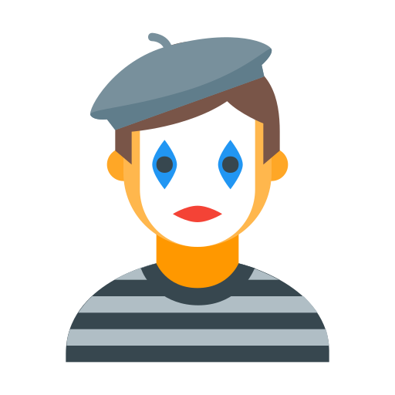

VOCABULARY WORDS
코미디언 마을
comedian
village

Slide 3
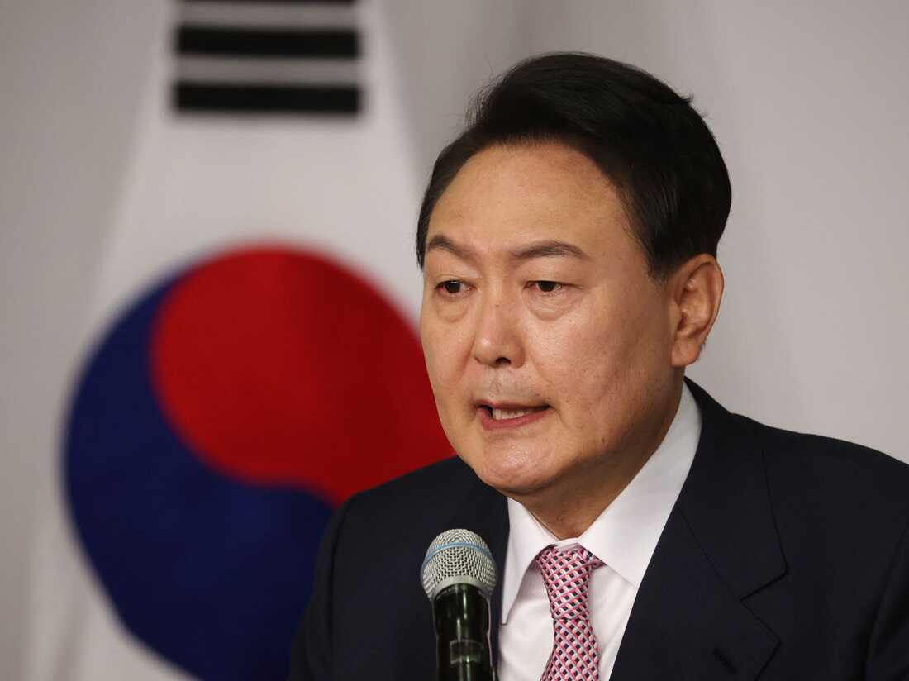
VOCABULARY WORDS
대통령
president

Slide 4
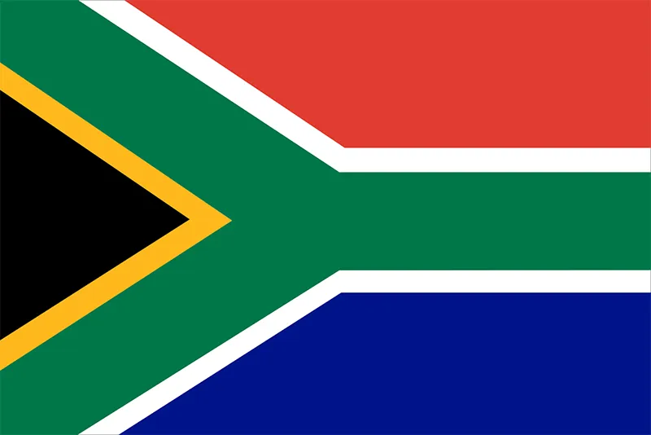


LET’S LEARN ABOUT SOUTH AFRICA
South Africa
Color the letters with South Africa’s flag colors
Draw the South African flag here
Cape Town
Bloemfontein and Pretoria
Capital Cities: ___________
________________________

Slide 5
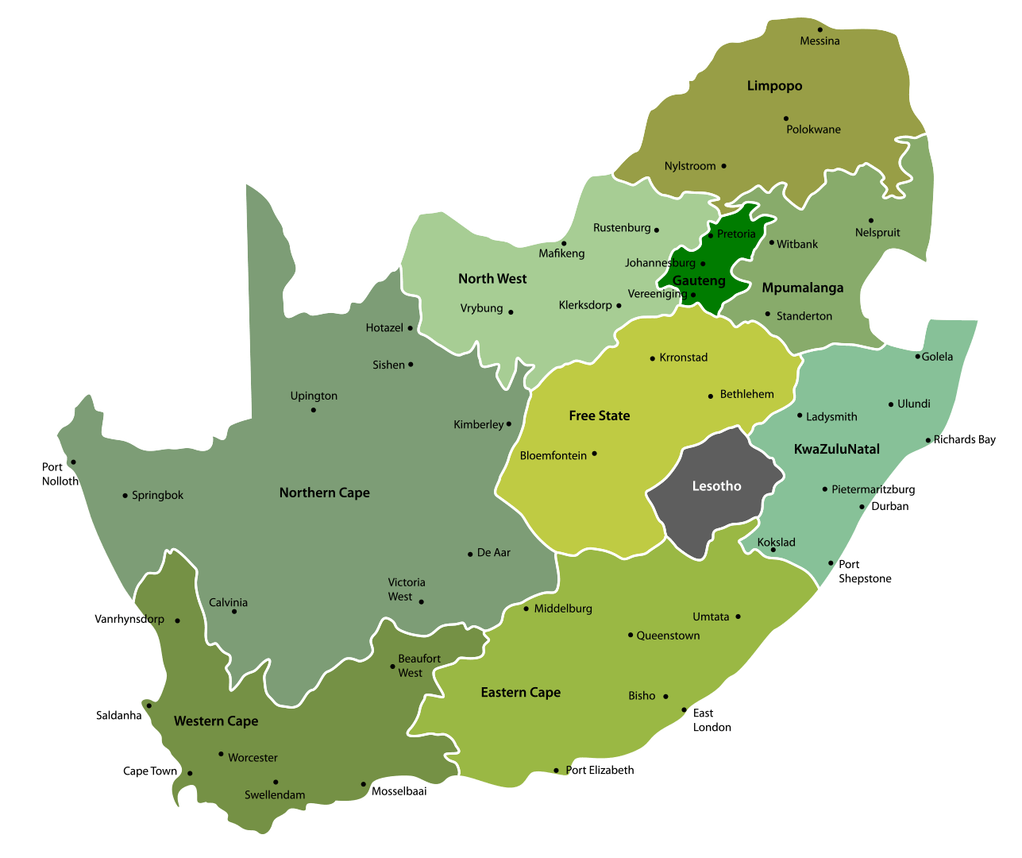
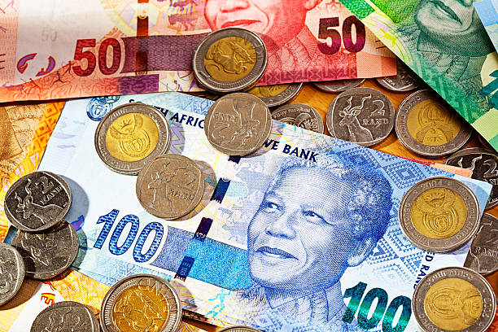
LET’S LEARN ABOUT SOUTH AFRICA
South Africa has
official languages!
South African Rands
Cut and paste in your book
11

Slide 6
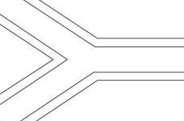
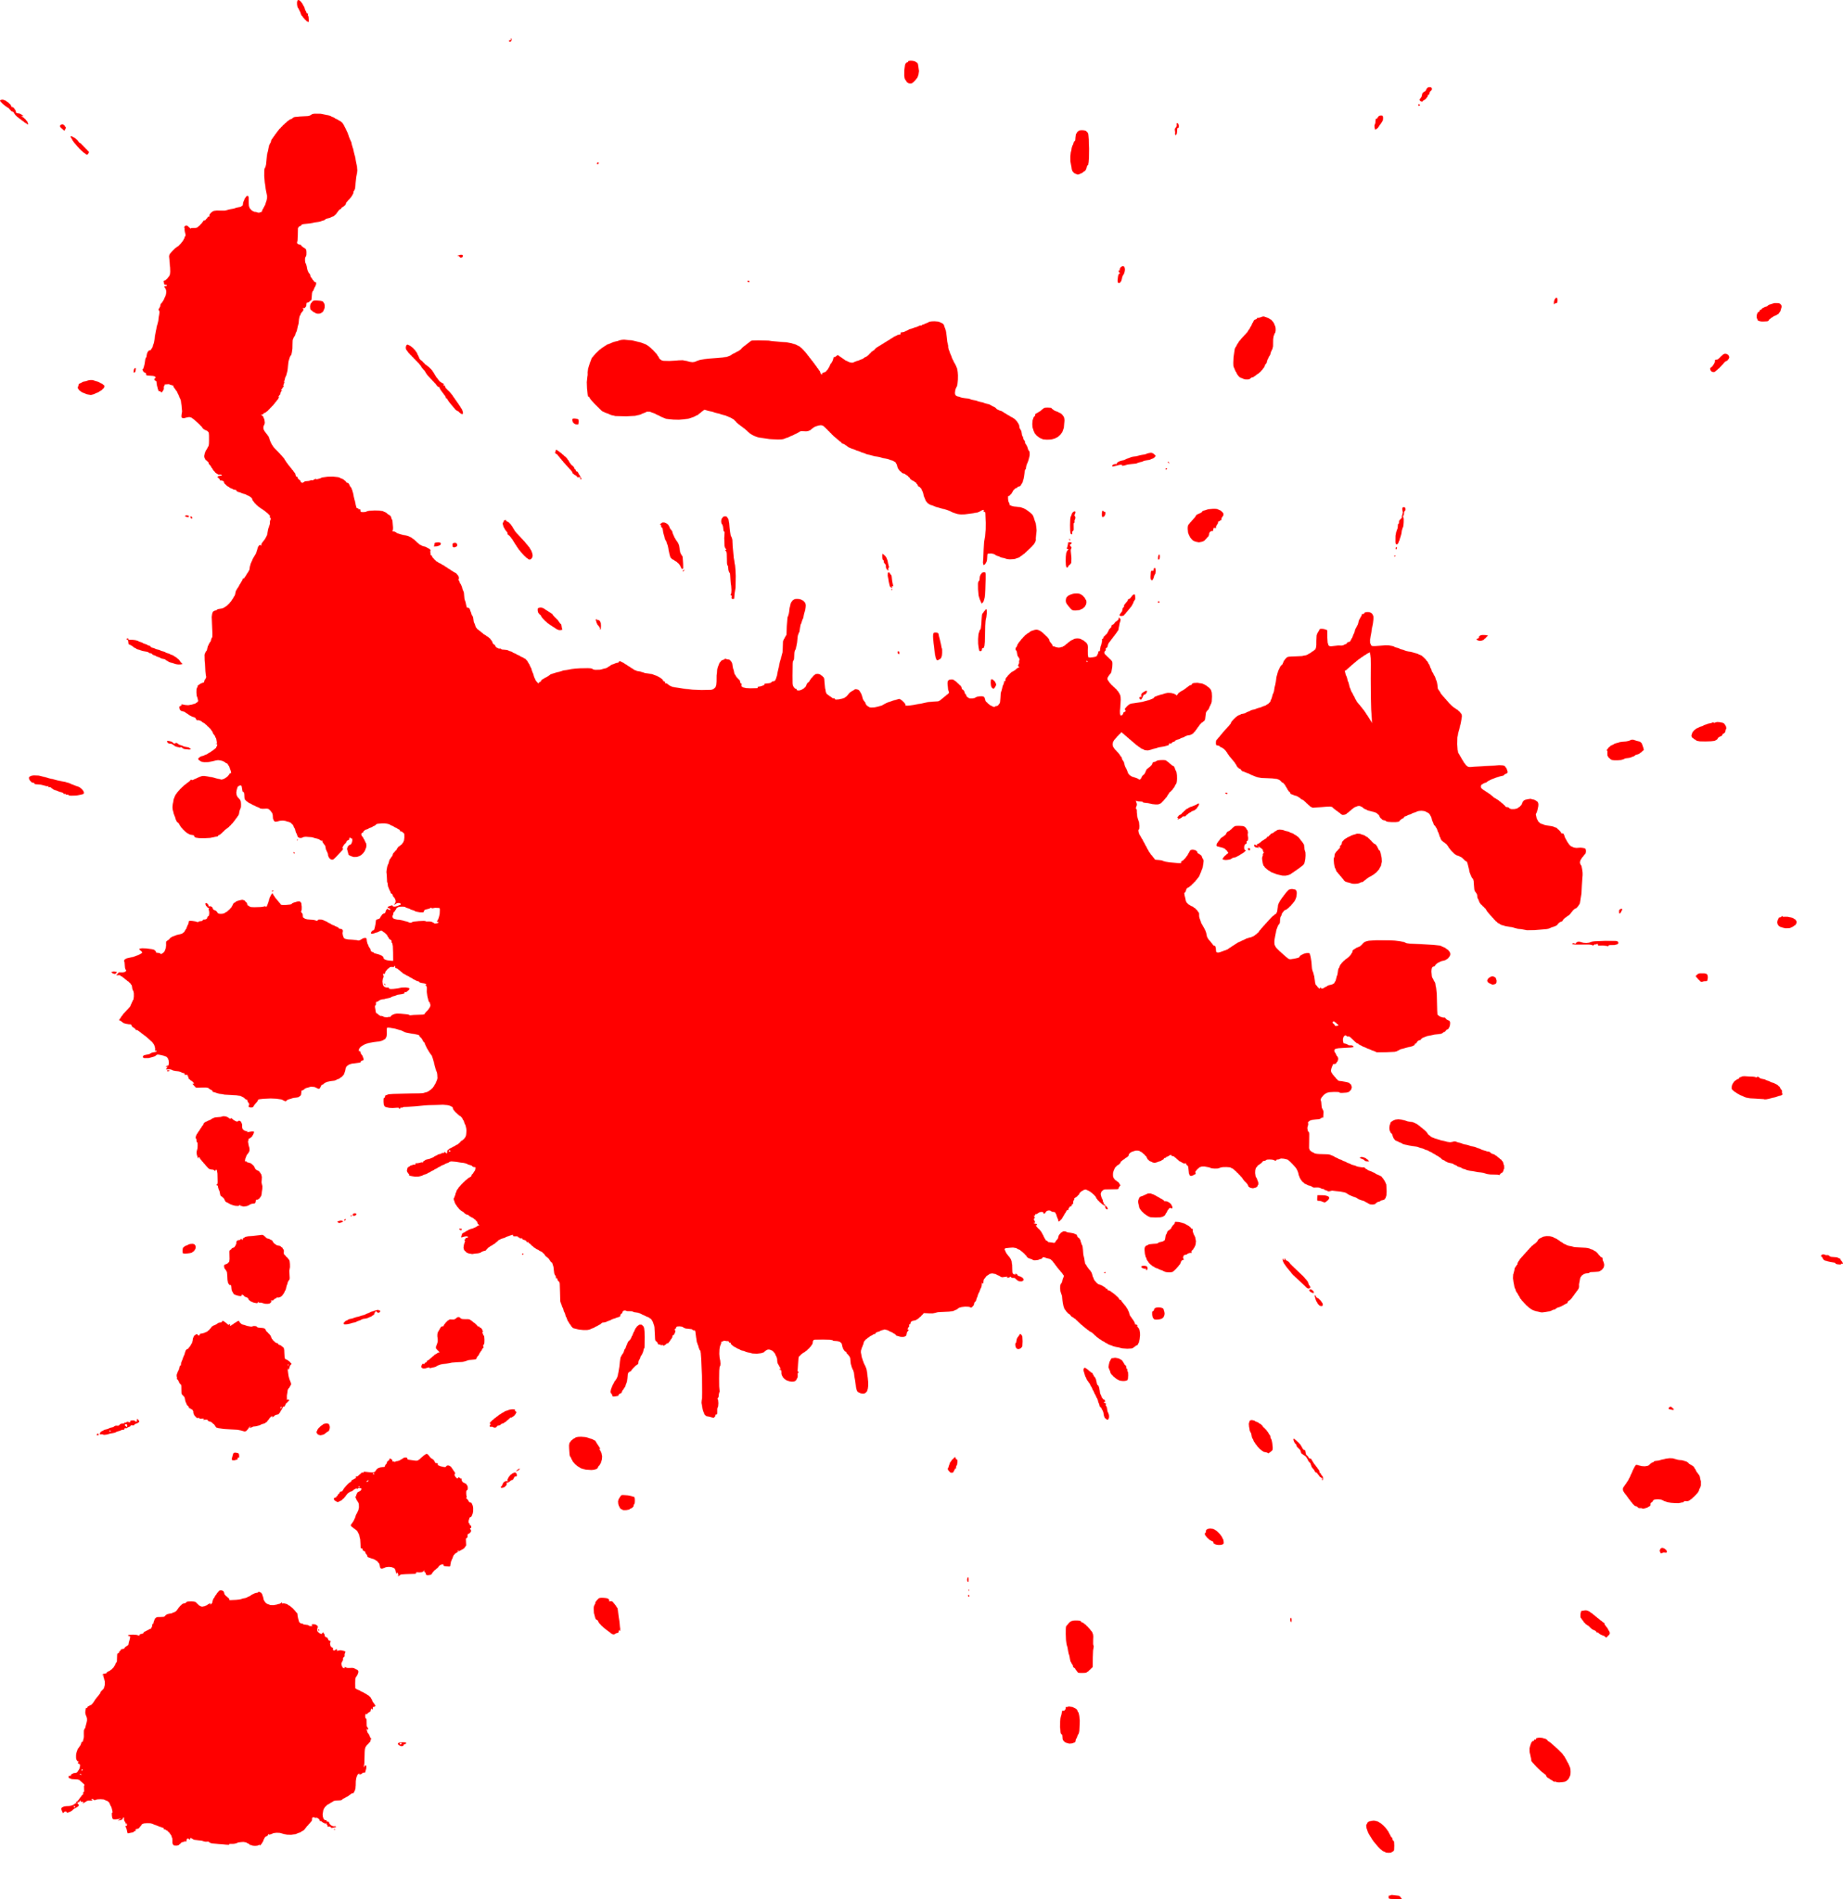





WHAT COLOR IS IT?

Slide 7
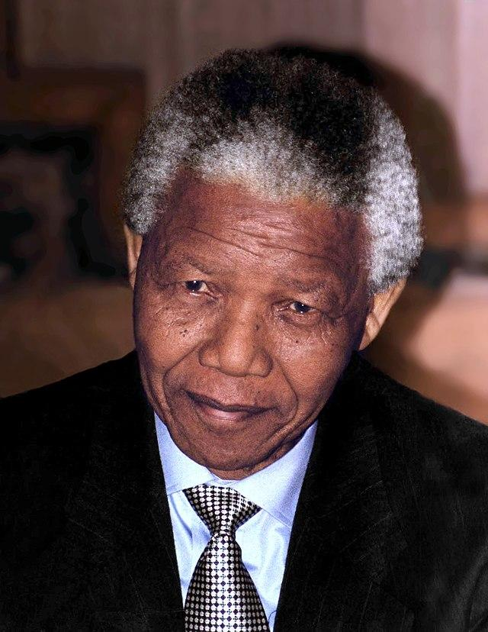
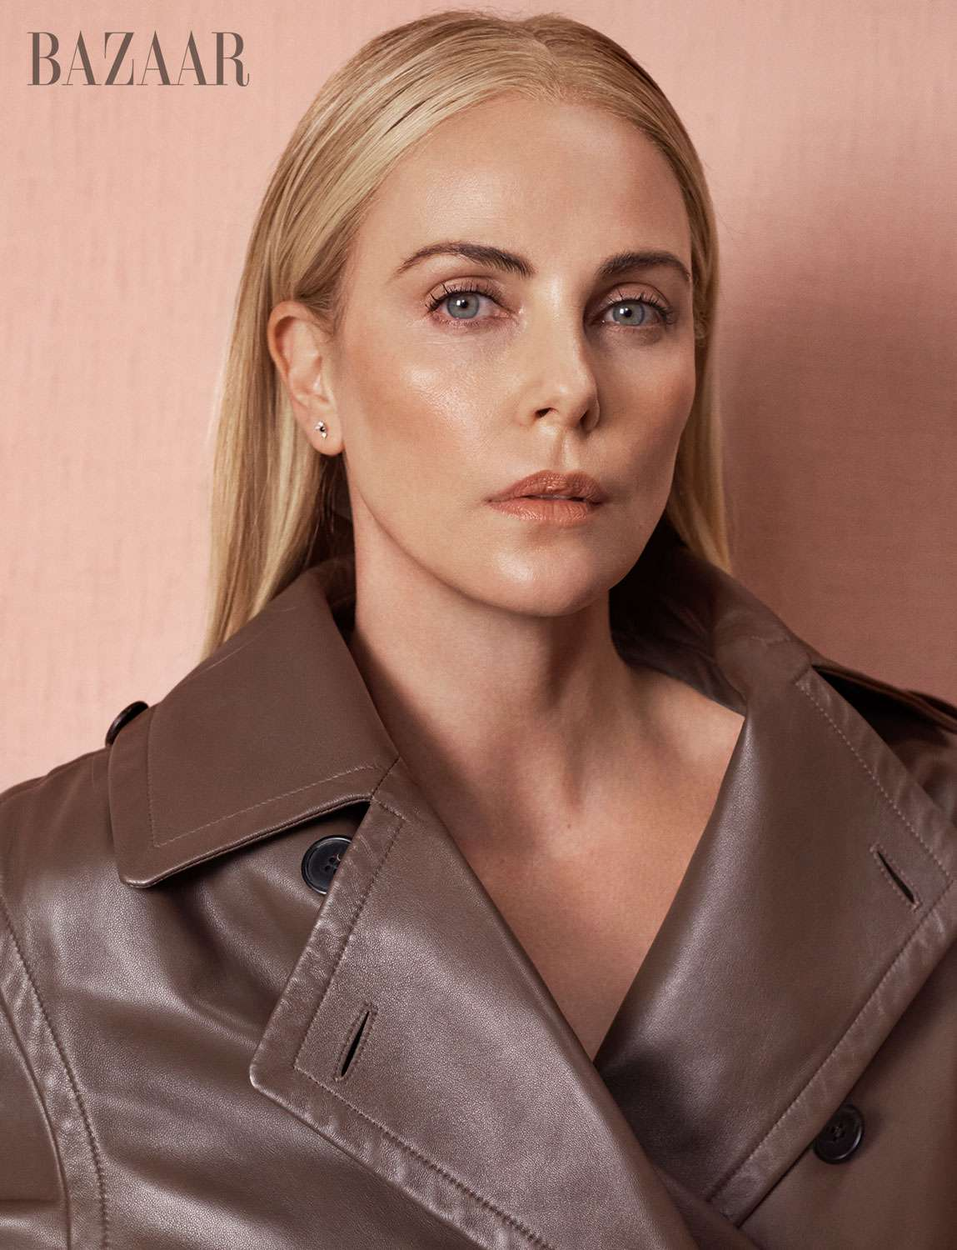
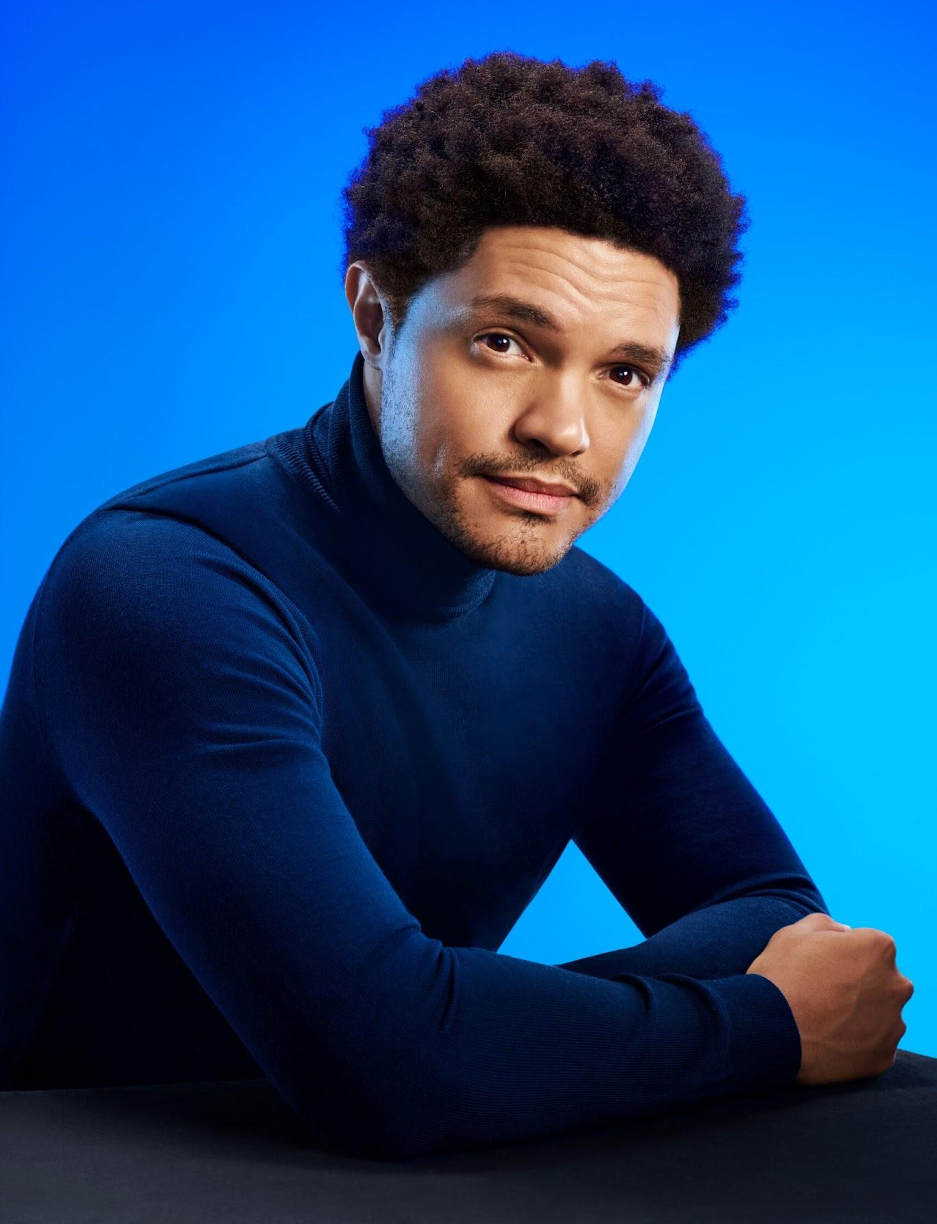
FAMOUS PEOPLE FROM SOUTH AFRICA
I’m Nelson Mandela. I was the __________
_______________________________.
first president of united, South Africa
I’m Charlize Theron. I am an ____________.
I’m Trevor Noah, I am a _____________.
comedian
actress

Slide 8
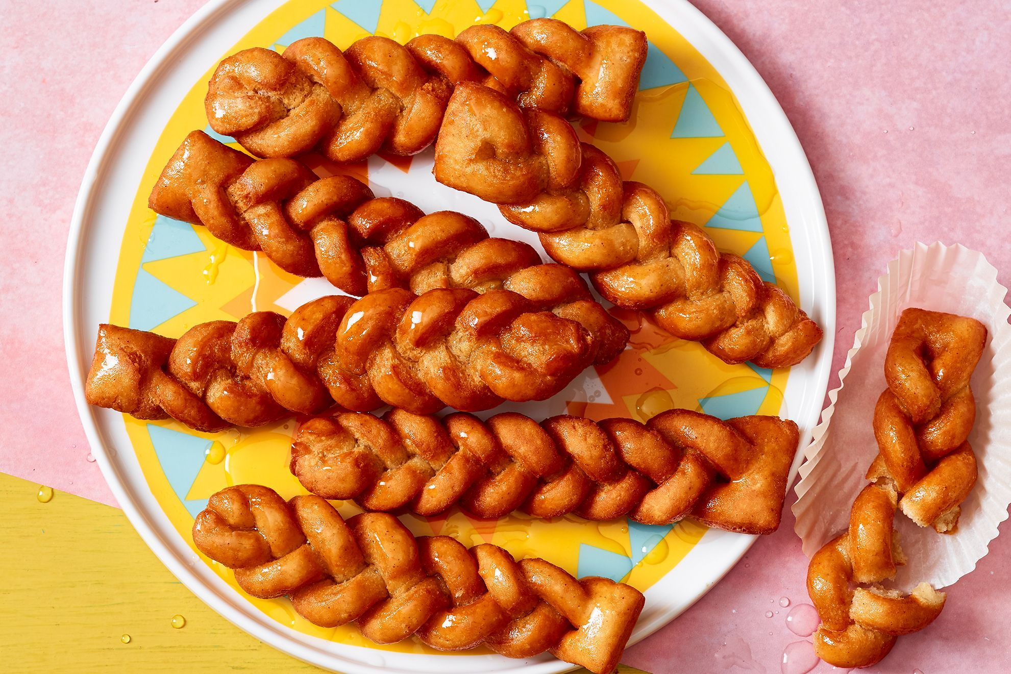
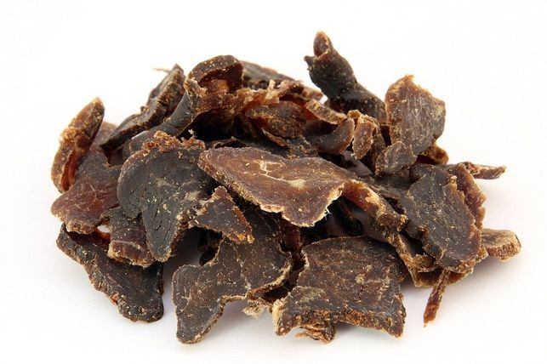
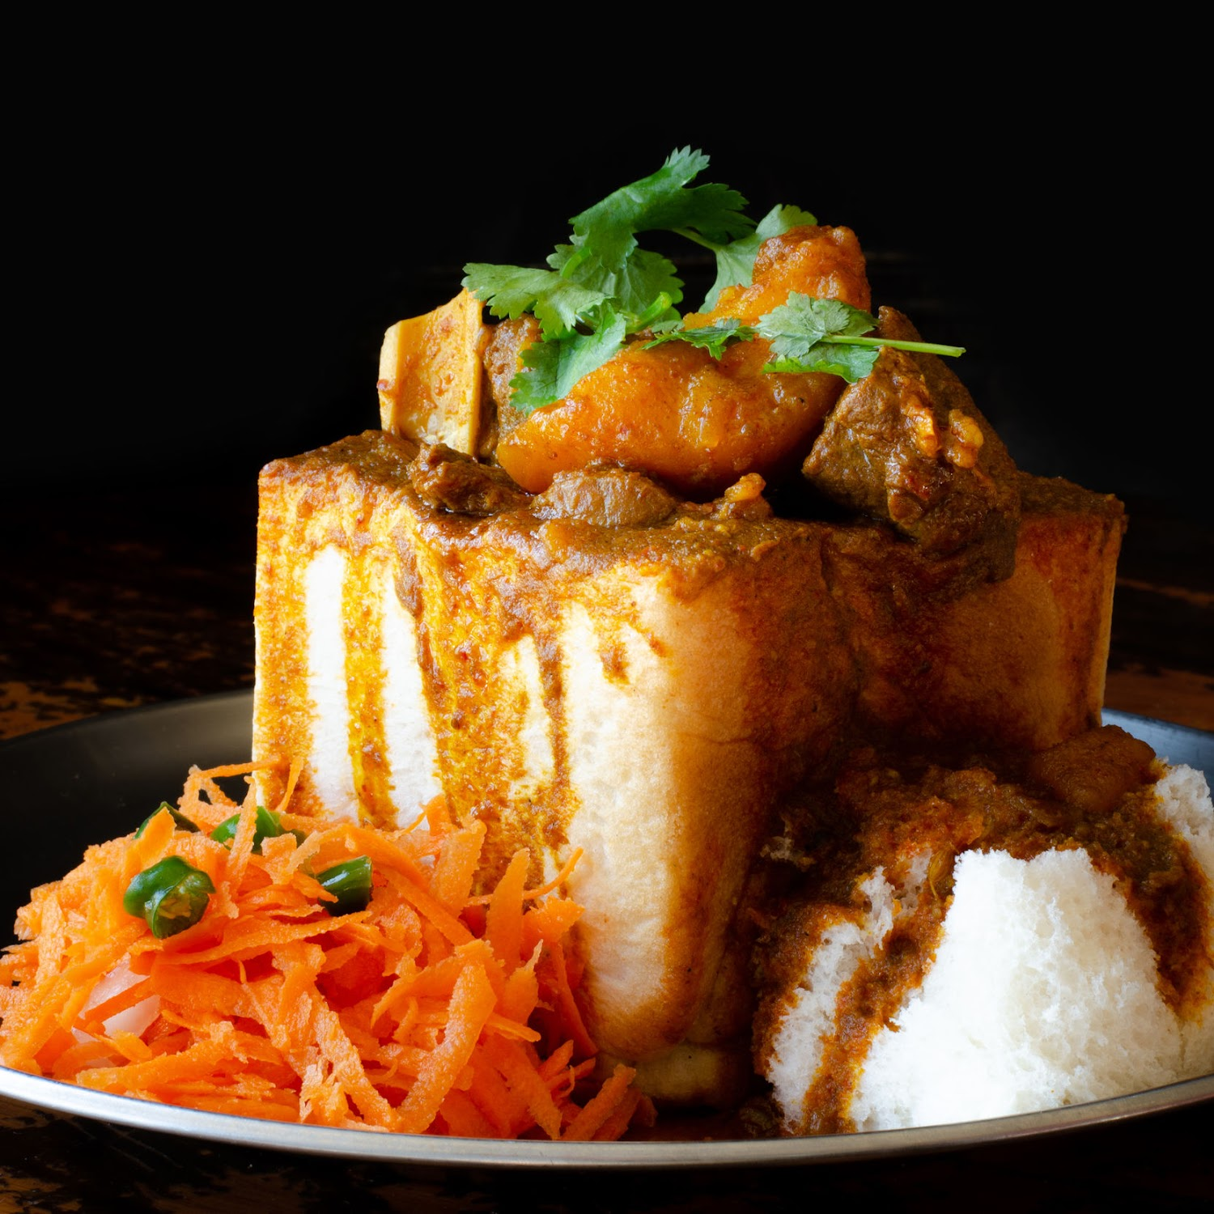
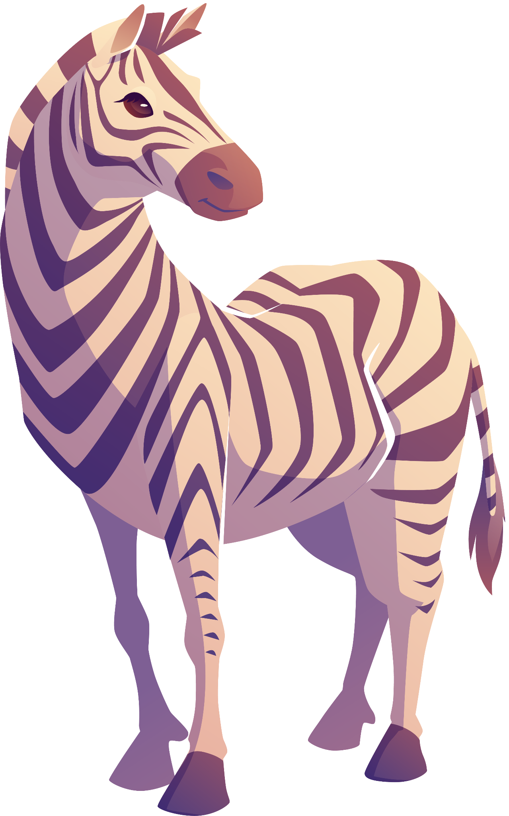

SOUTH AFRICAN FOOD
koeksister
biltong
bunny chow

Slide 9
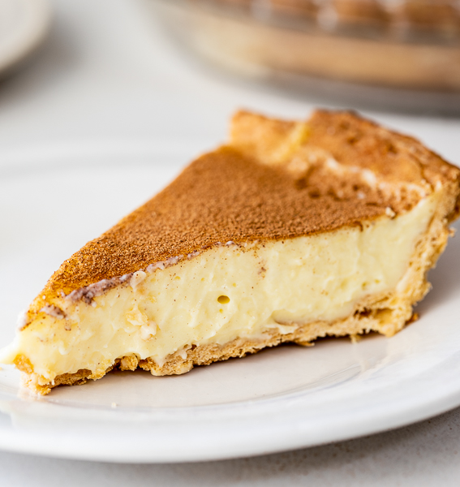
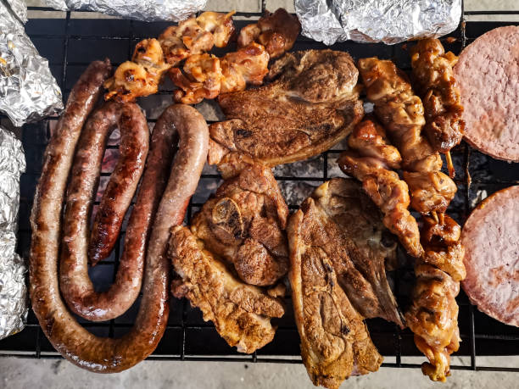
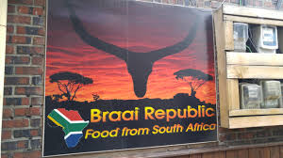

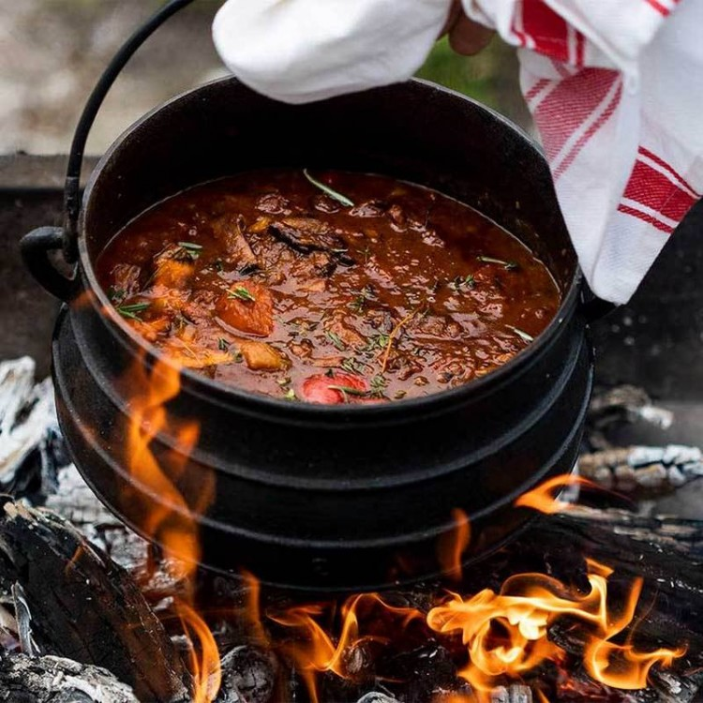
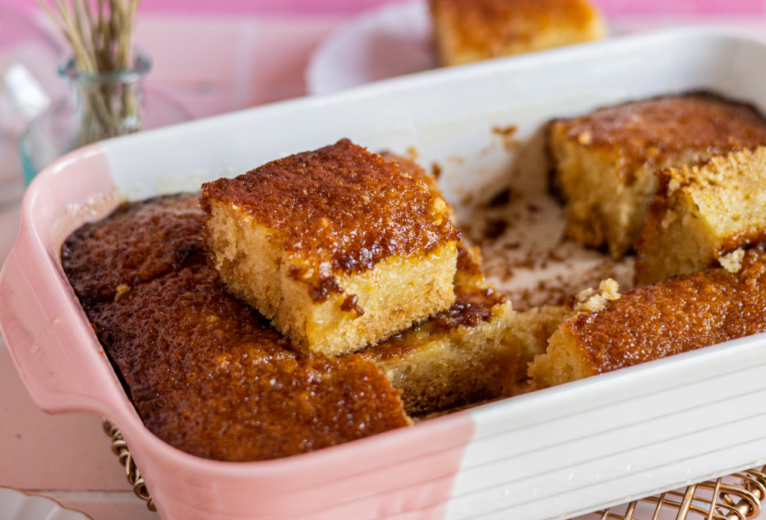
OTHER SOUTH AFRICAN FOOD
Milk tart
Braai
Malva pudding
Potjie

Slide 10





THE BIG FIVE
The five best animals to see on a safari
lion
buffalo
elephant
rhinoceros
leopard

Slide 11

NDEBELE HUTS

Slide 12
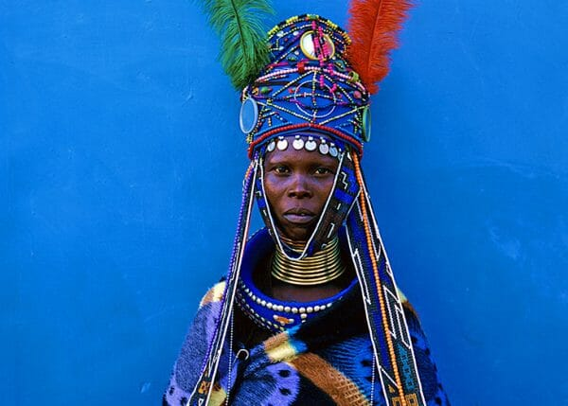
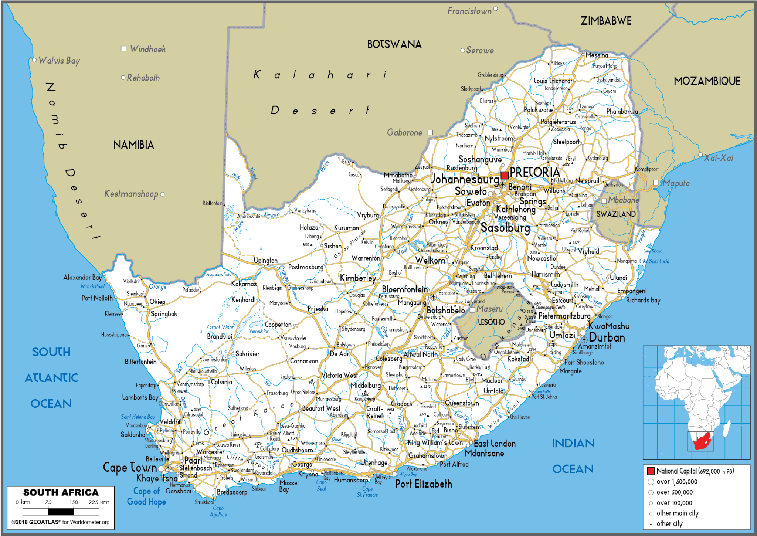
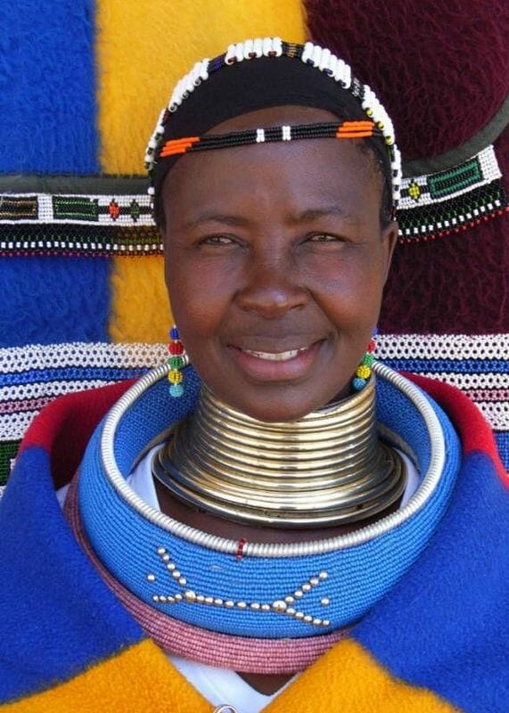

Slide 13
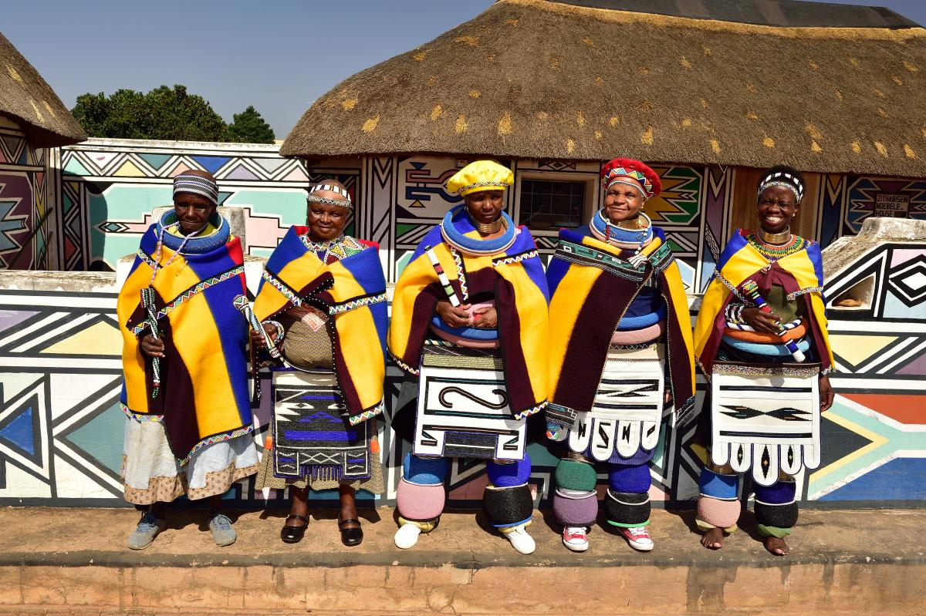
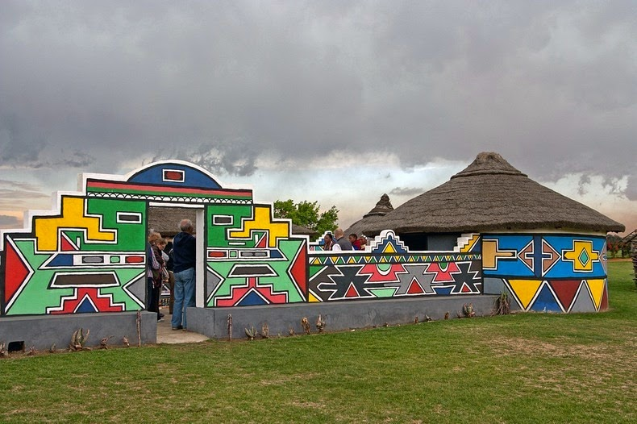
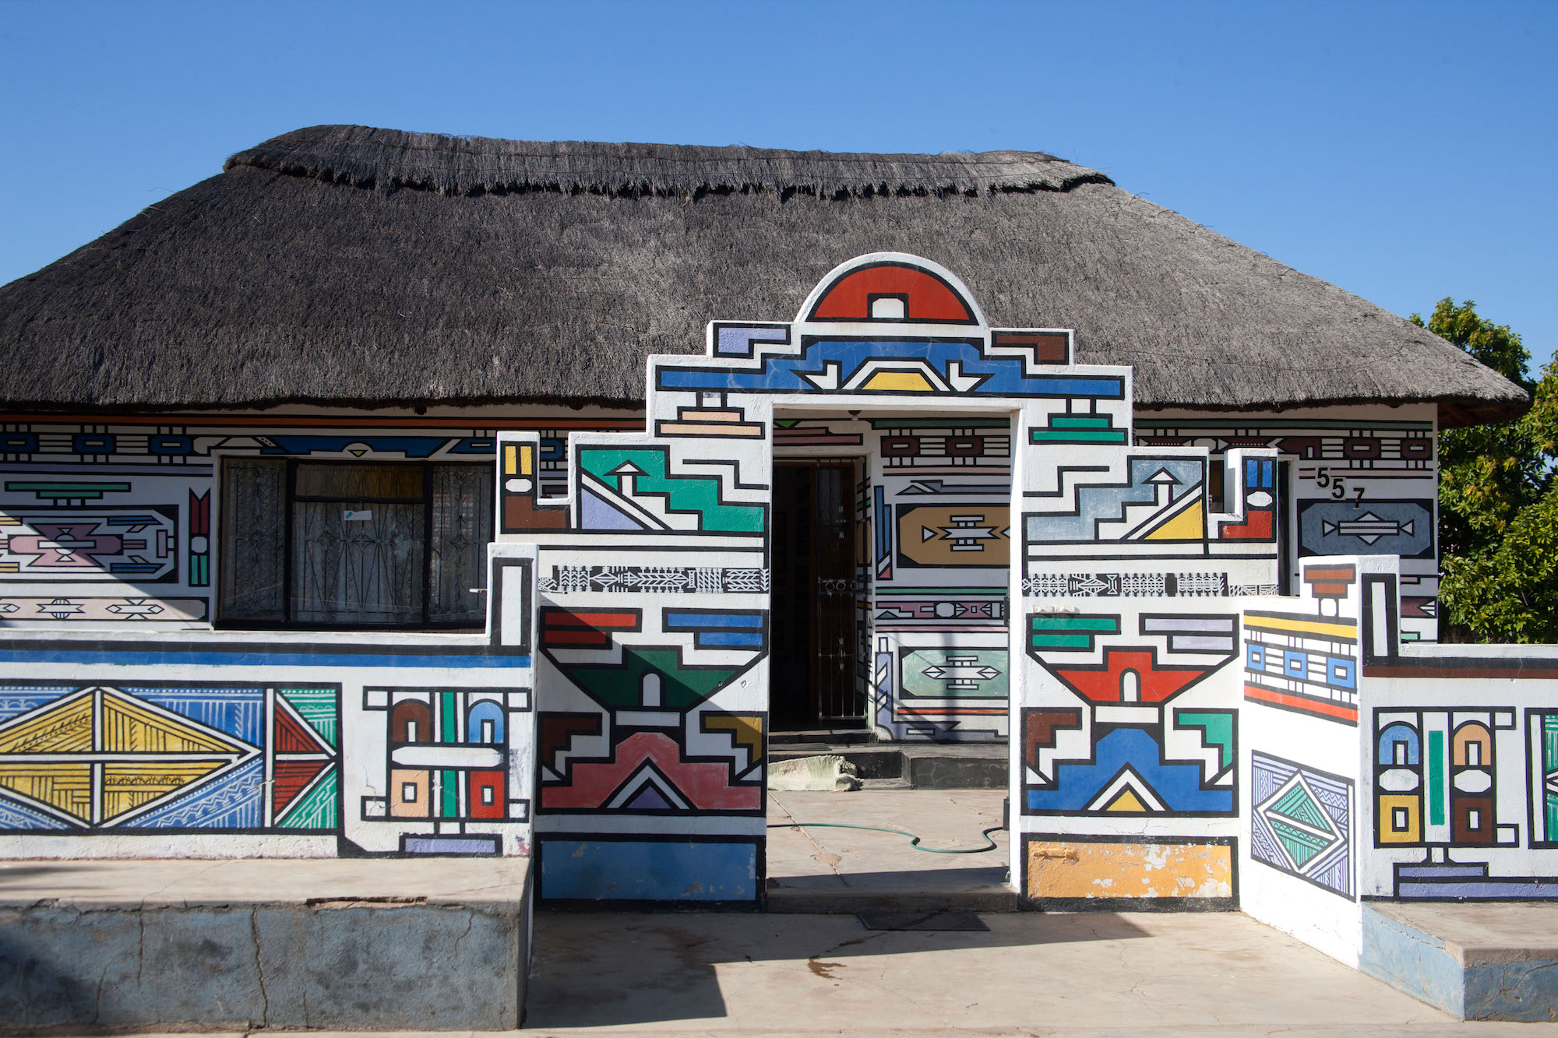
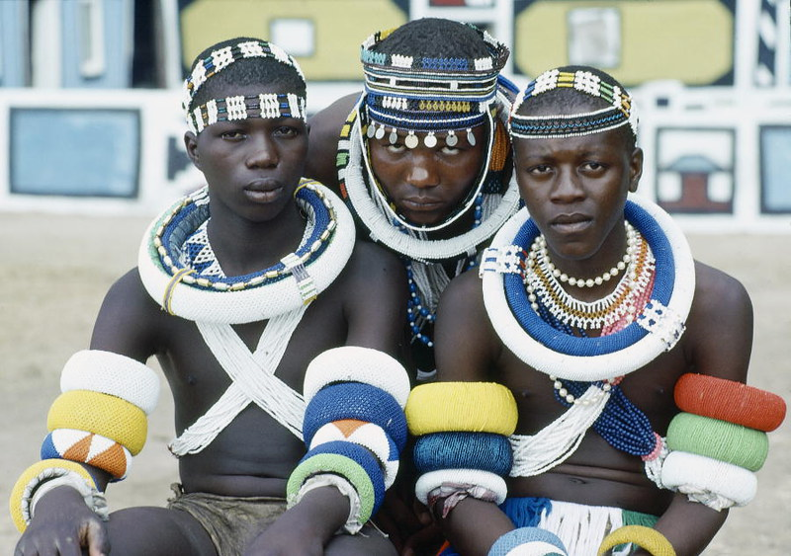

Slide 14
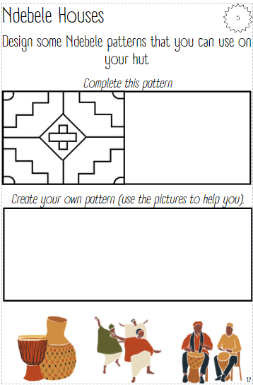
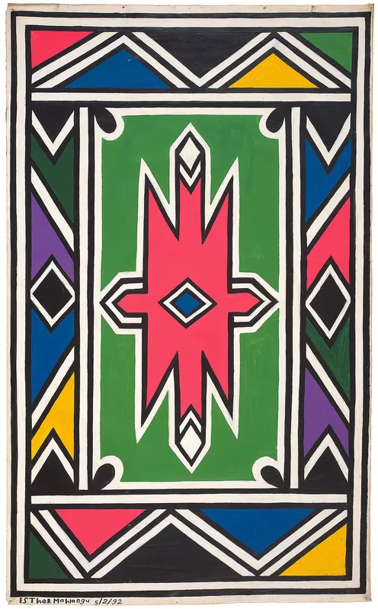

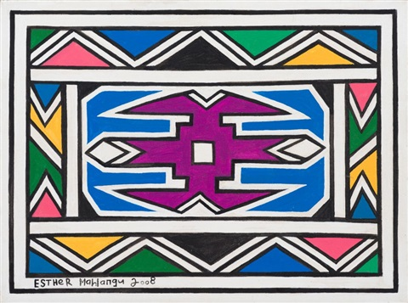
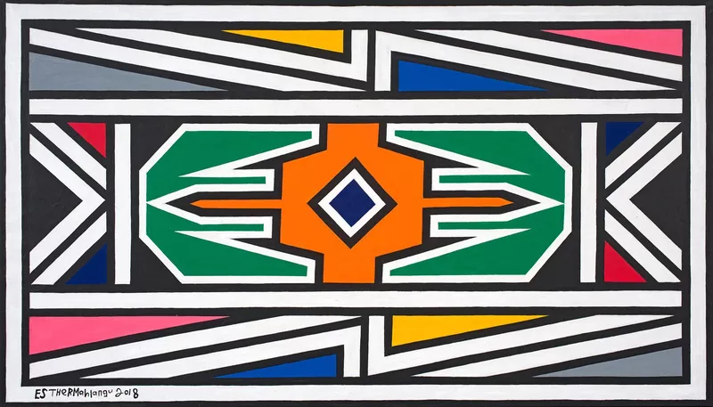
Complete the pattern
Create your own Ndebele pattern

Slide 15
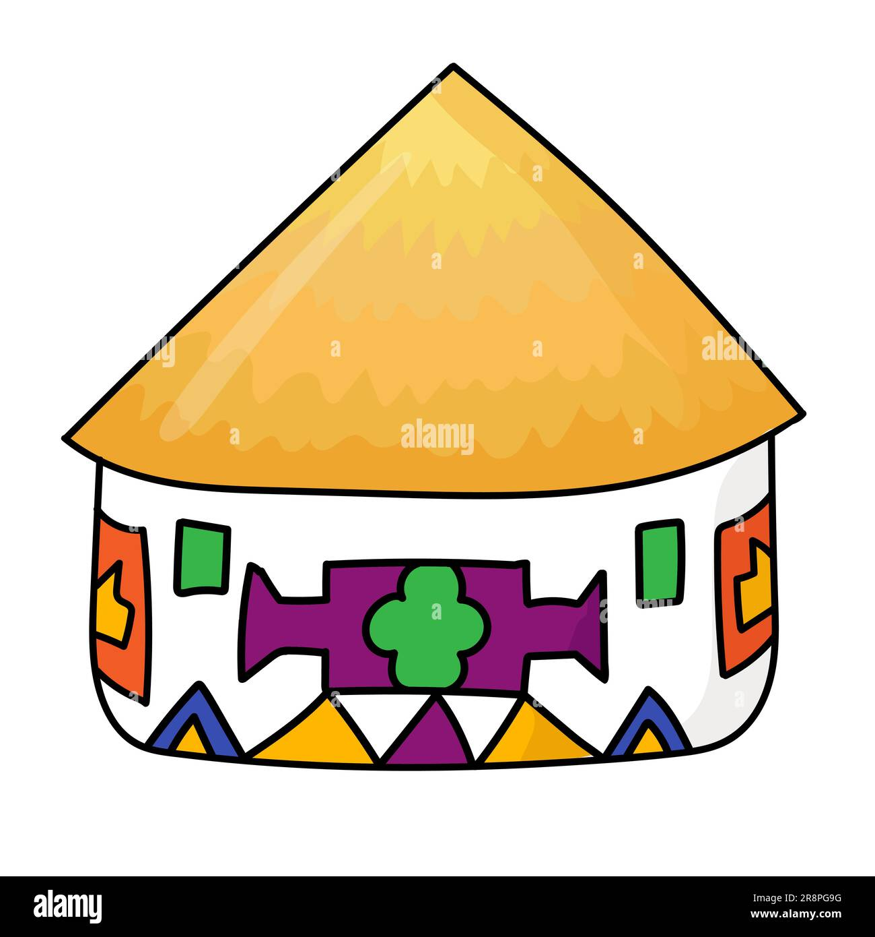
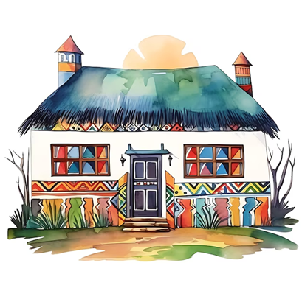
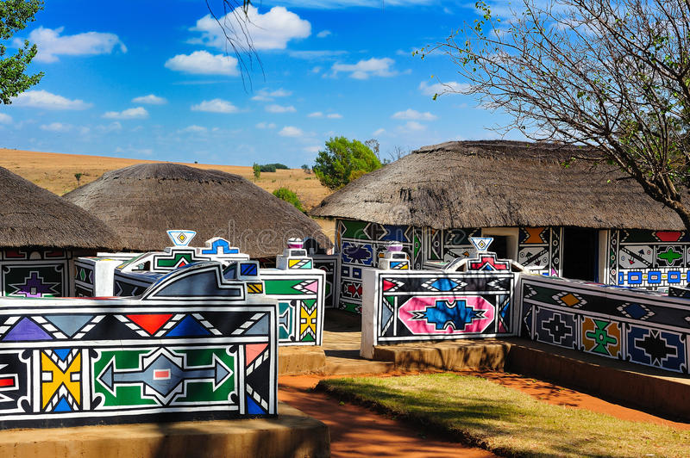
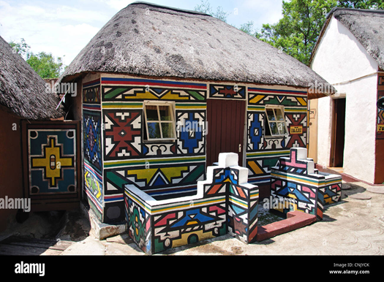
NDEBELE HUTS
Now you will make your own Ndebele Village

Slide 16

CATEGORIES GAME

Slide 17
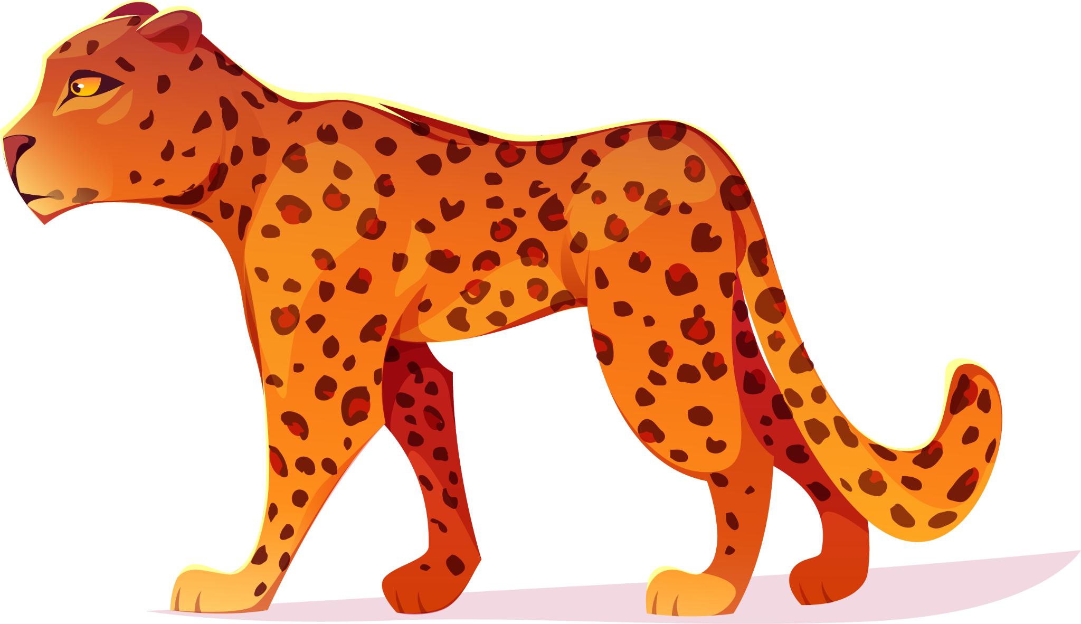
PASSPORT WRTING

Slide 18
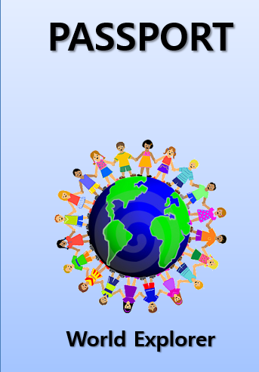
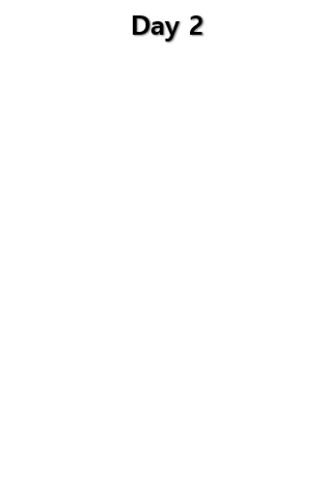
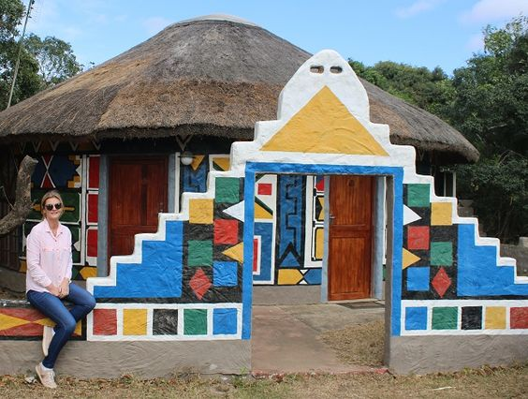
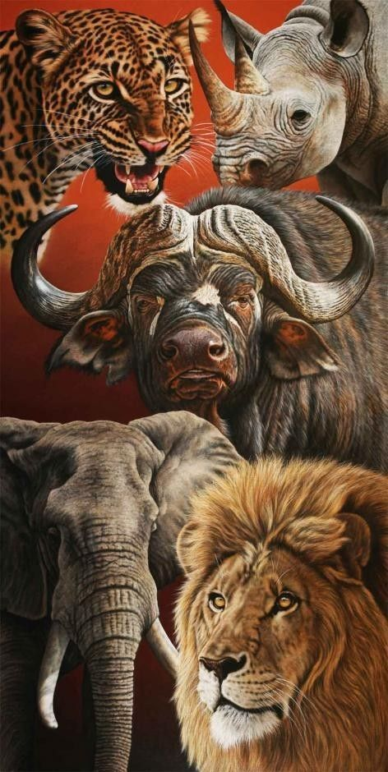
PASSPORT WRITING

Slide 19
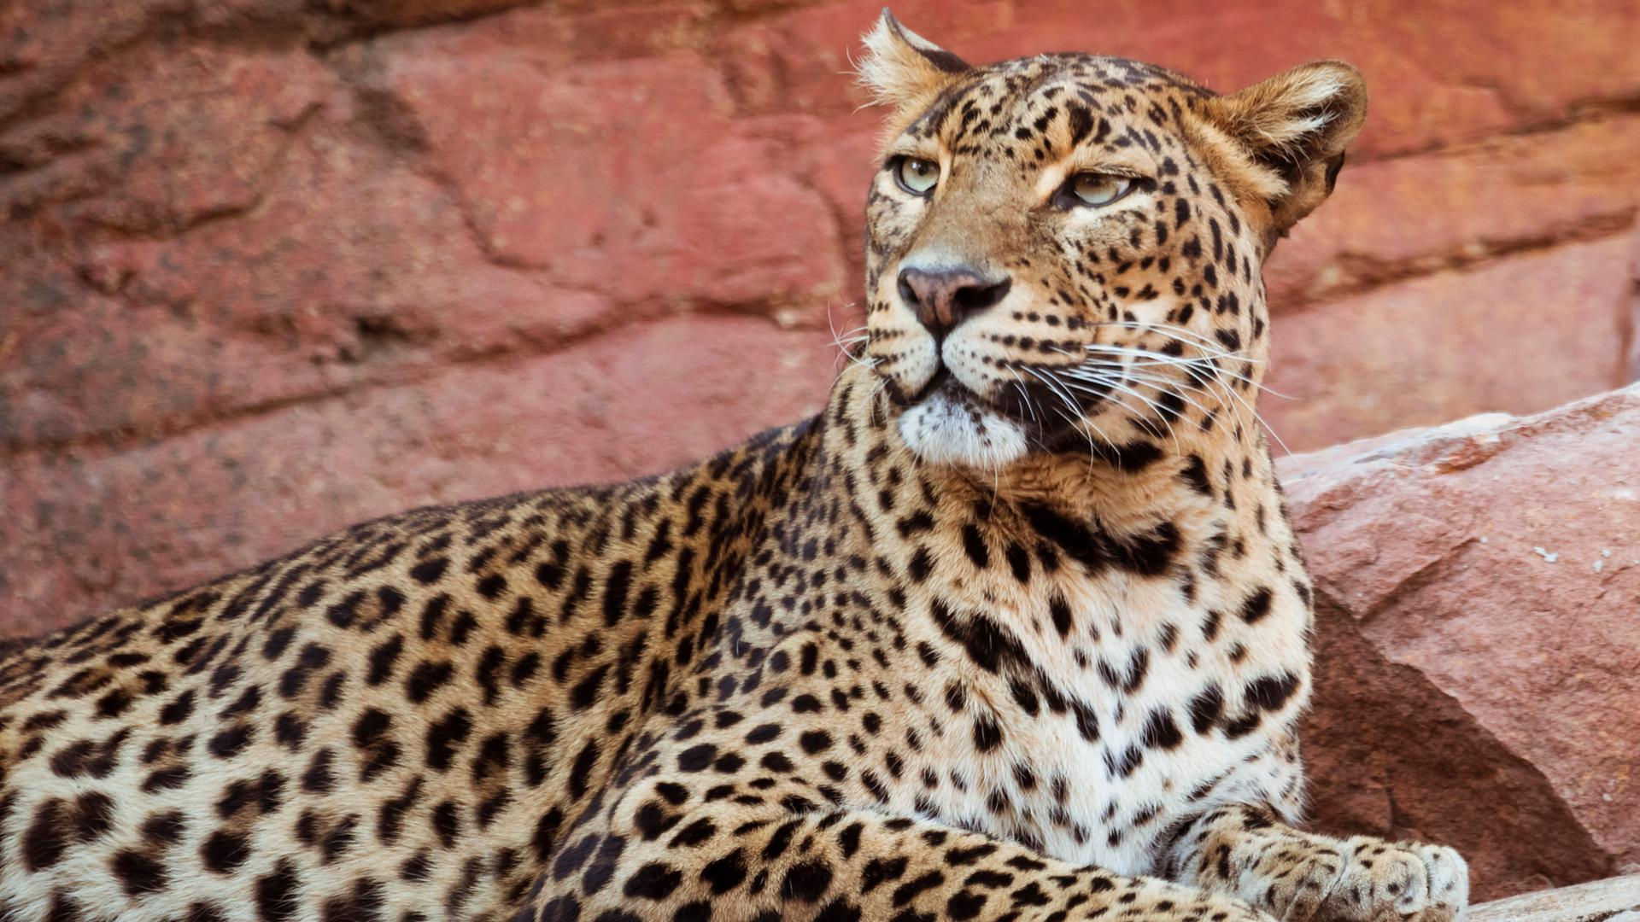
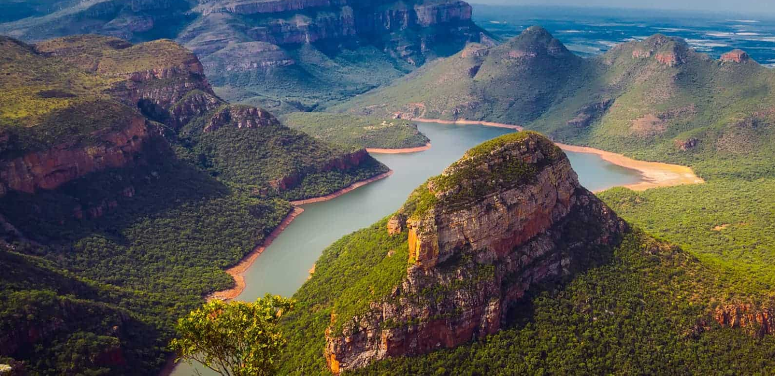
SEE YOU TOMORROW FOR DAY 3!

Slide 20
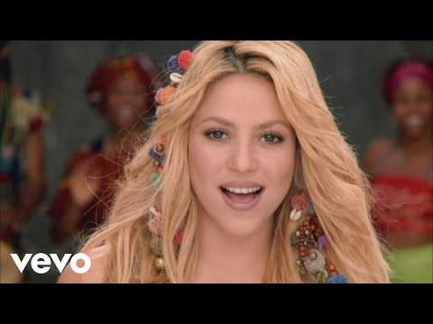
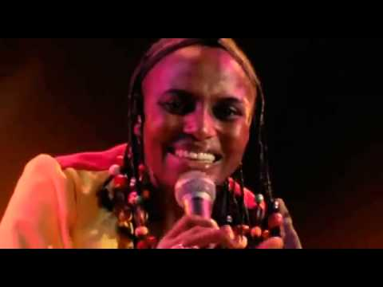
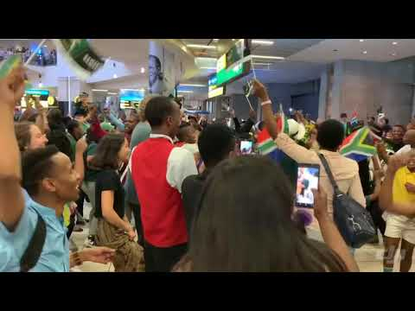
2010 FIFA WORLD CUP

